Slide 1
MindEase

Slide 2

MindEase
Your AI Emotional Support Companion
MindEase is an AI-powered emotional support and counselor connection platform. It's built with Flutter and Dart for a seamless, cross-platform experience, ensuring accessibility on various devices.

Slide 3
Problem Statement
The Growing Mental Health Crisis
1 in 4 people face mental health issues.
Therapy is slow; stigma prevents seeking help.
Many lack resources for immediate support.

Slide 4
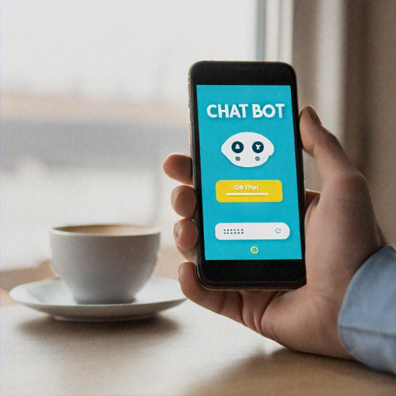
Our Solution
24/7 Mental Health Chatbot
AI support and coping techniques
Connect to licensed counsellors
Mood tracking and wellness tips
Built with Flutter for performance

Slide 5
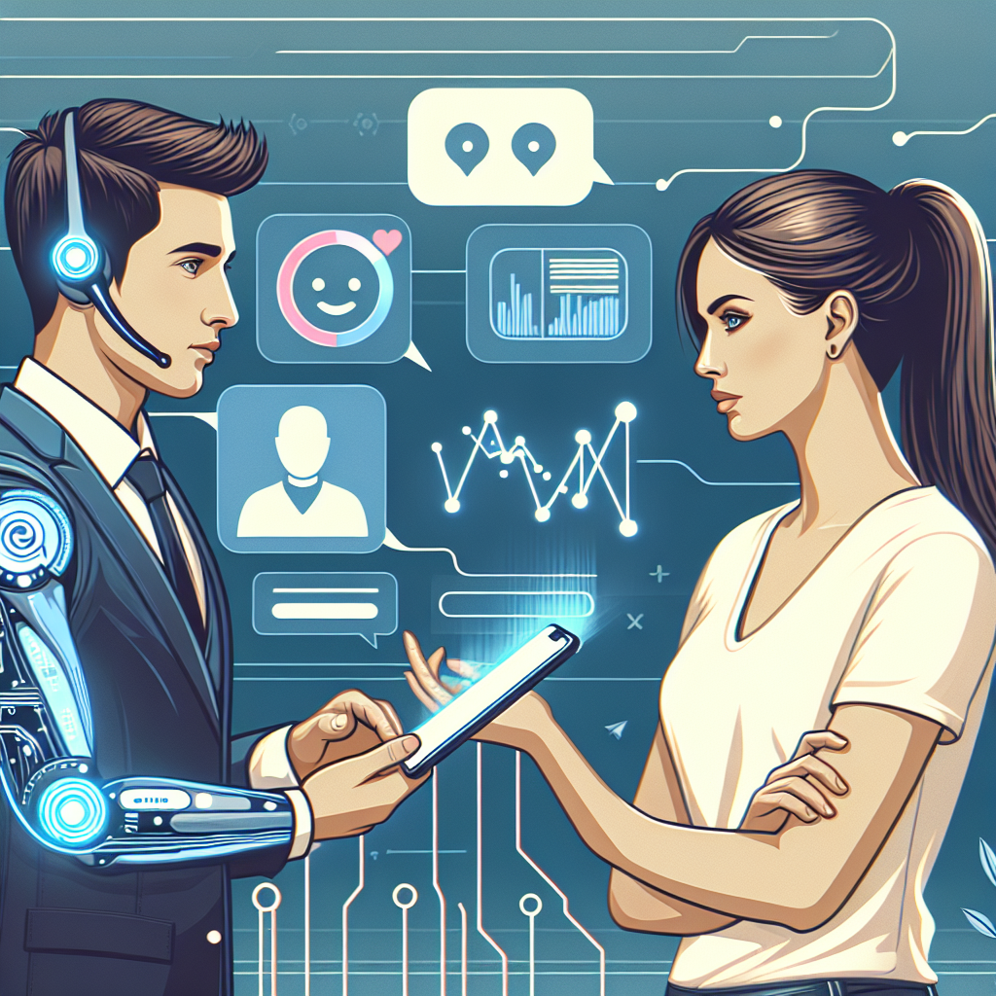
How It Works
AI chatbot offers instant support.
Connect to counselors when needed.
Track mood, get personalized insights.
Access articles, exercises, crisis helplines.
24/7 availability for immediate help.
Easy access to mental wellness tools.

Slide 6
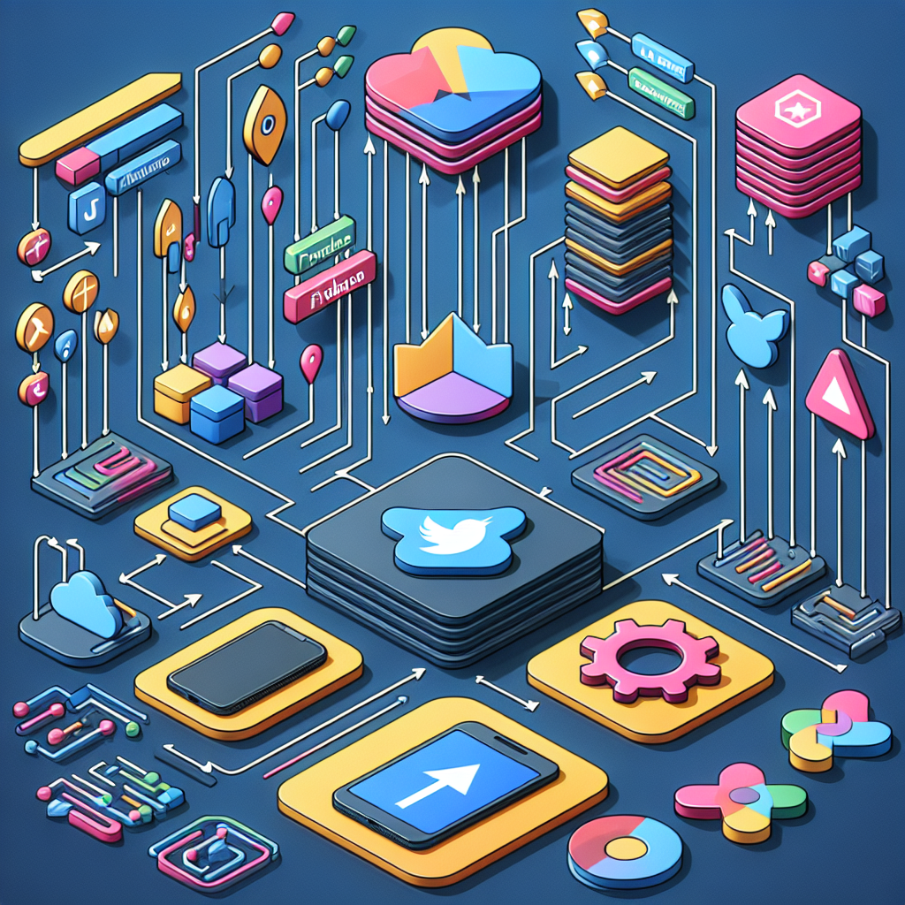
Technology Stack
MindEase uses a modern technology stack for optimal performance and scalability.
Flutter enables cross-platform support (iOS, Android, Web) from a single codebase.
Firebase/Supabase provides real-time database and authentication.
NLP models power the AI chatbot.
End-to-end encryption ensures secure communication.
Notes:
References:
- https://flutter.dev/multi-platform
- https://dart.dev/multiplatform-apps
- https://www.jetbrains.com/help/kotlin-multiplatform-dev/kotlin-multiplatform-flutter.html

Slide 7
Business Model
Free: Basic chatbot & self-help.
Premium: Unlimited access, advanced insights.
B2B: Partnerships with organizations.
Notes:
References:
- https://vocal.media/journal/monetization-strategies-for-mental-health-apps-in-2025

Slide 8
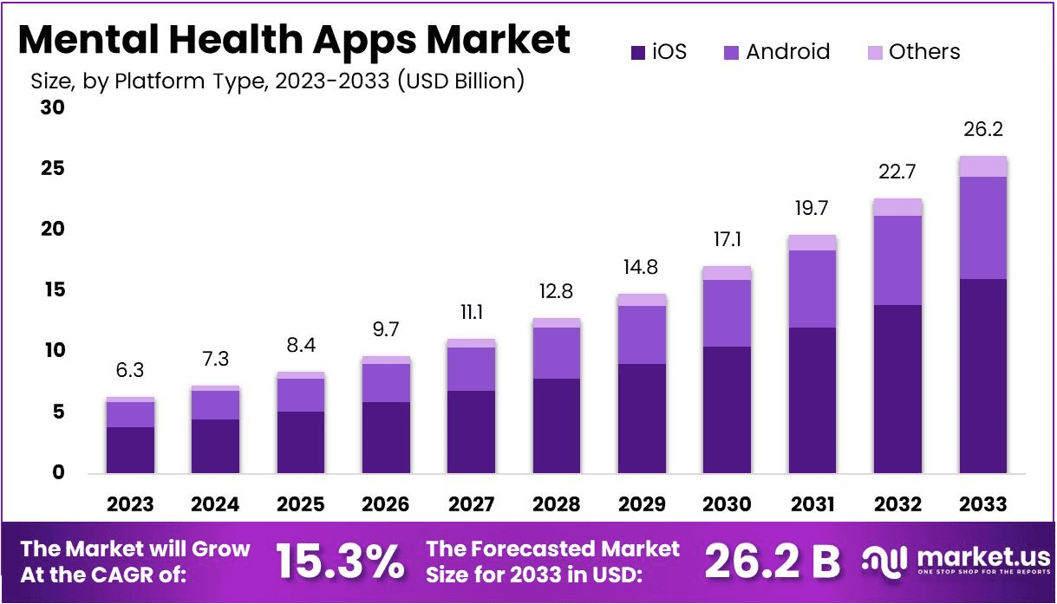
Market Opportunity
$5.2B market in 2023
Expected to reach $11B by 2030
Targeting young adults (18–35)
Corporate employees with stress
Students facing anxiety and depression
Notes:
References:
- https://www.marketresearch.com/DataM-Intelligence-4Market-Research-LLP-v4207/Global-Mental-Health-Apps-39660466/

Slide 9

Competitive Advantage
MindEase offers a unique blend of AI and human support, going beyond typical chatbots. Built with Flutter, it ensures faster development and a smoother user experience. Prioritizing user privacy with HIPAA/GDPR compliance, it provides affordable therapy options.
Notes:
References:
- https://svitla.com/blog/mental-health-app-development/
- https://sda.company/blog/category/mental-health/mental-health-app-monetization

Slide 10
Traction & Roadmap
Phase 1: MVP, counsellor matching
Phase 2: Mood tracking & premium features
Phase 3: Global expansion with multilingual support

Slide 11

We need your support to make mental health accessible! Seeking investors, mental health partners, and beta testers to join us.
Contact us at joycegrace331@gmail.com to help.

